Slide 1
Guided Capstone One
Resort Project Report

Slide 2
Problem Identification
The objective of this project is to develop a pricing model for The Big Mountain Resort
The Resort may not be maximising its returns relative to its market position on ticket sales
Ticket prices are invariably related to what patrons value on their visit to the resort
The project aims to build a model that visitors are willing to pay for relative to features offered at the resort

Slide 3
Exploratory Data Analysis
Montana, home of the big mountain resort, has 11 other resorts
Although New York has 33 resorts, each one is rather smaller than resorts in Montana; Montana has fewer, but larger ski resorts.
Montana also ranks top 5 in resorts per 100k capita, with only New Hampshire, Wyoming, and Vermont ranking higher.
Skiable Area and resort per 100k capita are an important features to patron that visit the Montana resorts.

Slide 4
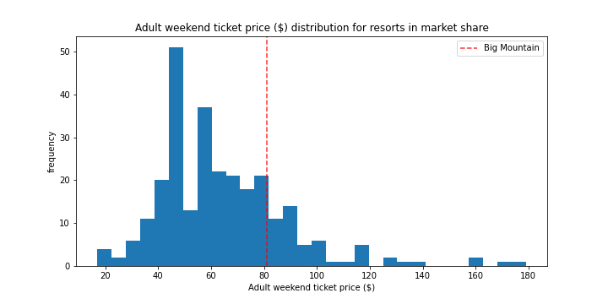
Modeling Results and Analysis
Big Mountain Resort modeled price is about $96 while current price charged to patrons is $81
Ticket prices of other resorts ranged from $20 to about $180, with Big Mountain resort falling somewhere in the middle.
Even with the expected mean absolute error of $10.39, there is still more room for an increase.
The models pricing relies on the assumption that other resorts are accurately charging their patrons when controlling for operating costs.

Slide 5
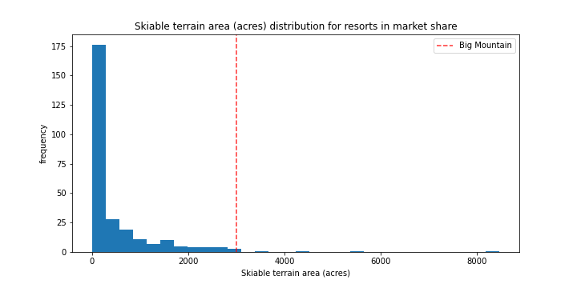
More Results and Analysis
Big Mountain Resort has skiable area of about 3000, which is one of the largest skiable terrain among other resorts.
Skiable terrain is an important reason patrons are willing to pay more on ticket prices

Slide 6
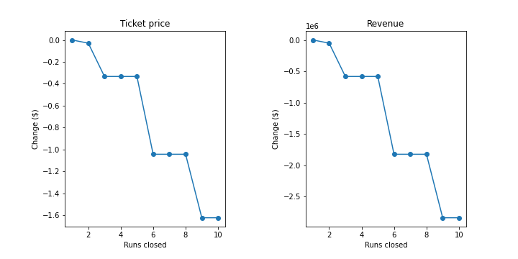
Recommendations:
Scenario 1
Closing just one run would not affect ticket prices or revenue.
Closing an additional 2 and 3 runs reduces revenue and ticket prices
Eliminating 4 runs would be the same as eliminating 5 and 6 runs; shutdowns in either case would result in no further loss in ticket price and revenue.
A drop lower than 6 runs leads to a significant drop in ticket prices and revenue.

Slide 7
Recommendations:
Scenario 2
In this scenario, Big Mountain can add one more run, increase the vertical drop by 150 ft, and construct another chair lift.
This case allows for an increase in ticket price by about $1
Revenue would amount to $1724638 during the ski season

Slide 8
Recommendations:
Scenario 3
Big Mountain resort can add two more acres of snow
This case does not make much difference from the second scenario as it also leads to same revenue and ticket price increases.

Slide 9
Recommendations:
Scenario 4
Big Mountain Resort could increase runs by .2 miles and add 4 more acres of snow
This case leads to no change in the ticket prices or revenue

Slide 10
Conclusion
Scenarios 2 and 3 lead to the greatest price increases in ticket sales.
These scenarios lead to roughly the same amounts in revenue.

